Slide 1
Model-based Approaches as Guidance to Bioequivalence Decision Making: Design and Analysis Considerations
Andrew C. Hooker, Ph.D.
Associate Professor of Pharmacometrics
Dept. of Pharmaceutical Biosciences
Uppsala University
Uppsala, Sweden

Slide 2
Standard bioequivalence (BE) studies
Standard BE analysis strategies have been shown to perform adequately in ”typical” drug studies when dense PK sampling is possible.
However, dense sampling is not always possible: anti-cancer, children and ophthalmic studies.

Slide 3
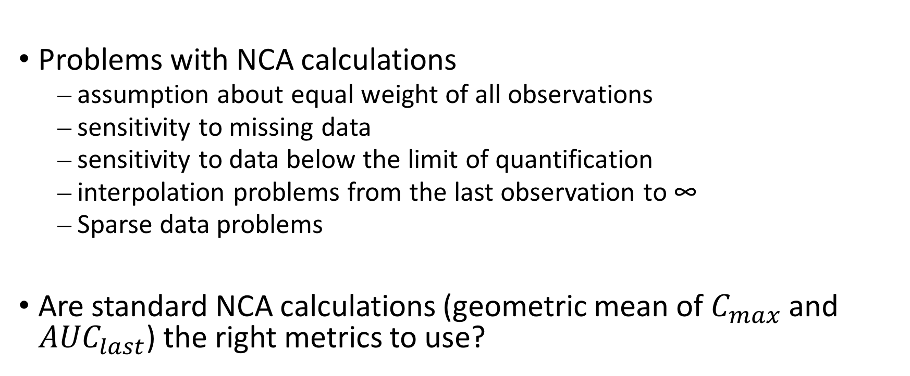
Potential problems with standard BE approaches
Problems with NCA calculations
  assumption about equal weight of all observations
  sensitivity to missing data
  sensitivity to data below the limit of quantification
  interpolation problems from the last observation to ∞
  Sparse data problems
Are standard NCA calculations (geometric mean of $C_{max}$ and ${AUC}_{last}$) the right metrics to use?

Slide 4
Population (NLME) model based approaches in general can handle these problems
Problems solved:
  assumption about equal weight of all observations
  sensitivity to missing data
  sensitivity to data below the limit of quantification
  interpolation problems from the last observation to ∞
  Sparse data problems
Simulations of expected PK profiles give an understanding of what features may be important to compare in a BE study
PKPD models give an indication of the PK factors driving drug effect

Slide 5
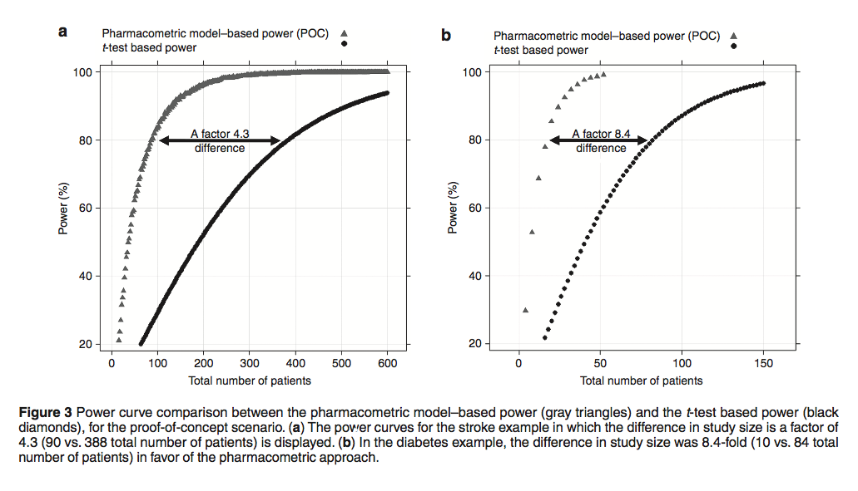
Advantages of pharmacometric approaches

Slide 6
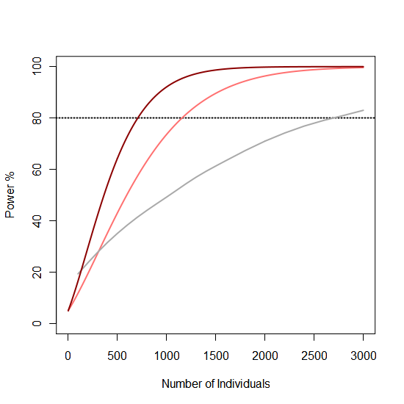
Advantages of optimal design of experiments
(Optimized) Model Based vs.
Traditional Data Analysis in Alzheimer's
1443 (2.2 X)
1892 (3.6 X)
Model-Based Analysis
(Optimized for power)
Model-Based Analysis
(Default Design)
Traditional Analysis
(Unstructured MMRM model,
LSMeans)
Hooker et al., Model-based Trial Optimization for Phase II and III designs
in Alzheimer's Disease, ACOP, 2011
Notes:
What is traditional analysis called?
1540
1120
Get factor difference
Need to define design that we are looking at

Slide 7
The “ultimate” model-based BE approach
Pop PK model(s) developed for BE studies
BE-study data
Optimal design for BE study
Parameter estimation
+
Uncertainty quantification
Model
qualification
BE comparison
Model-based Computation of metrics of interest

Slide 8
Model components
Pop PK model(s) developed for BE studies
Ability to describe model parameter deviations based on:
Formulation
  Deviations in absorption, bioavailability
  Assume distribution kinetics to be the same
Period
Sequence

Slide 9
Potential problems with a model based analysis
The model is wrong (all models are wrong …)
Model building may produce bias
Parameters in a model may be biased/misspecified

Slide 10
Model averaging
Aoki et al., PAGE, 2014
Hooker et al., Workshop on dose finding and selection, EMA, 2014
Aoki et al., PAGE, 2016
PhIIb Dataset
2. Parameter estimation
3. LRT and Identifiability tests
4. Model selection
(AIC)
5. Simulation of quantity of interest
Mod 1
Mod 1
6. Summary of simulations (with model and parameter uncertainty)
Bootstrap data 1
Mod 2
X
Mod 3
Mod 3
Mod 4
Mod 4
1. Bootstrap of dataset
…
…
…
…
Mod 1
X
Bootstrap data n
Mod 2
Mod 2
Mod 3
Mod 3
Mod 4
Mod 4
7. Make a decision:
choose the lowest dose that has a probability of achieving target endpoint greater than a predefined limit.
Incorporate model and parameter uncertainty
Maintain type-I error
Reduce model selection bias
modelAVERAGE available on www.bluetree.me

Slide 11
Type of models to average with
Different potential distribution models
Different potential absorption models
  Absorption, bioavailability differences between formulation
Period, formulation effects if relevant

Slide 12
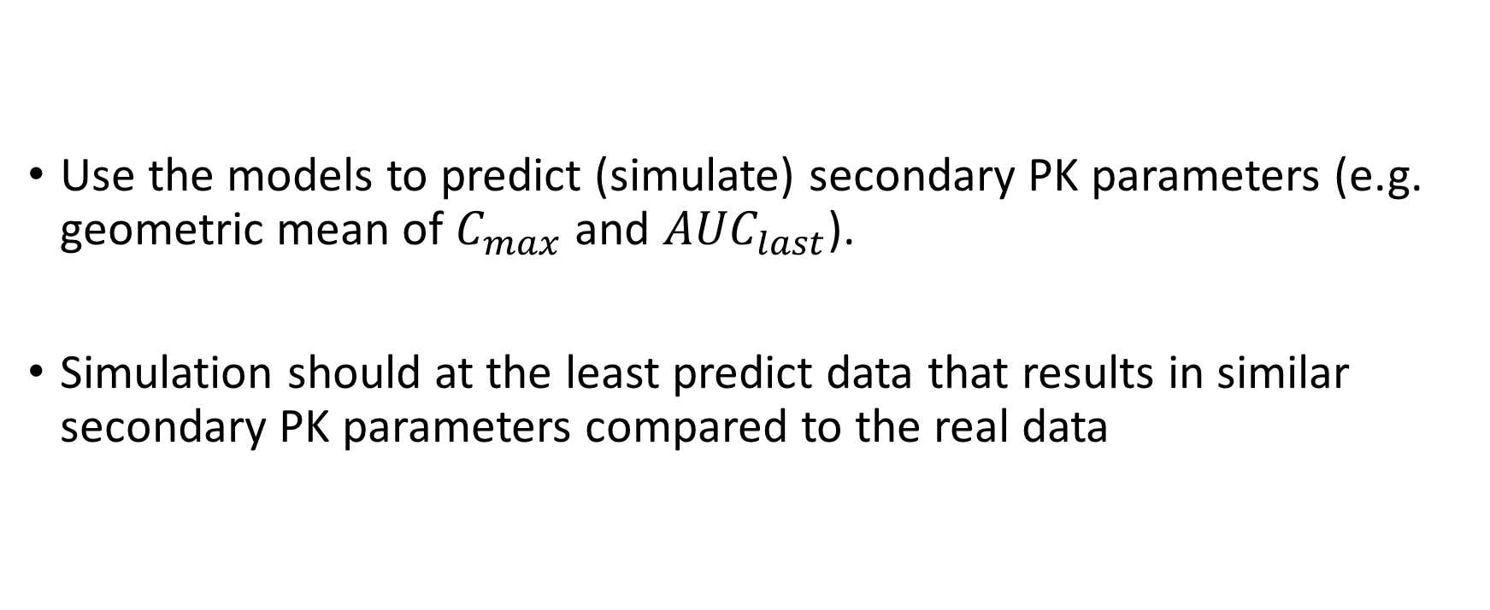
Model qualification
Use the models to predict (simulate) secondary PK parameters (e.g. geometric mean of $C_{max}$ and ${AUC}_{last}$).
Simulation should at the least predict data that results in similar secondary PK parameters compared to the real data

Slide 13
Non-compartmental analysis posterior predictive check (NCAPPC)
available on CRAN https://cran.r-project.org/package=ncappc
Notes:
Tack paper pucture

Slide 14
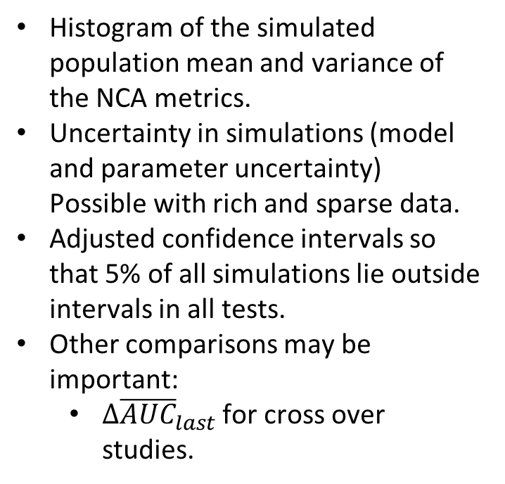
Comparison of the population mean and variance of NCA metrics
Histogram of the simulated population mean and variance of the NCA metrics.
Uncertainty in simulations (model and parameter uncertainty) Possible with rich and sparse data.
Adjusted confidence intervals so that 5% of all simulations lie outside intervals in all tests.
Other comparisons may be important:
  $Δ{\overline{AUC}}_{last}$ for cross over studies.

Slide 15
Uncertainty quantification
Dubois et al. (2011) improved the type-I error rates of their population model-based BE methods using a more realistic quantification of the parameter uncertainty (parametric bootstrap).
For sparse data and relatively few individuals, as in BE trials, the bootstrap may not be appropriate in providing reliable parameter uncertainty distributions (Niebecker, PAGE, 2013).

Slide 16
Sampling importance re-sampling (SIR) in NLME models (Implemented in PsN)

Slide 17
Performance of different uncertainty measures
SIR in population models can significantly improve the quantification of parameter uncertainty compared to a case-resampling bootstrap methodology.

Slide 18
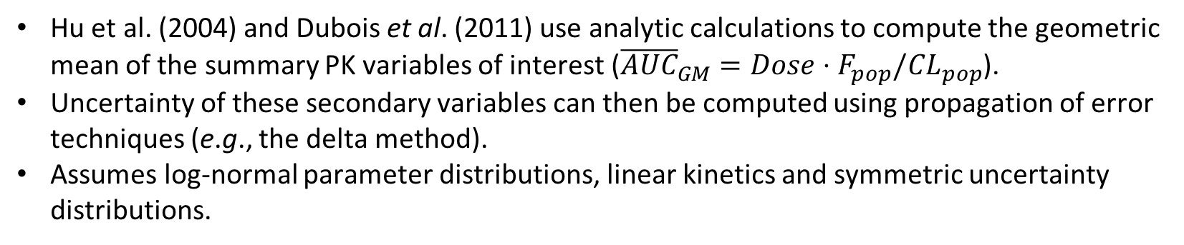
General algorithm for model based BE
Hu et al. (2004) and Dubois et al. (2011) use analytic calculations to compute the geometric mean of the summary PK variables of interest (${\overline{AUC}}_{GM}=Dose⋅F_{pop}/CL_{pop}$).
Uncertainty of these secondary variables can then be computed using propagation of error techniques (e.g., the delta method).
Assumes log-normal parameter distributions, linear kinetics and symmetric uncertainty distributions.

Slide 19
Proposed algorithm
Notes:
Need to update

Slide 20
Design issues
Absorption and treatment effect information is key!
Optimization of designs that focus on these parameters of interest (s-family designs).
Sampling for long half-life drugs may be considerably shortened if one assumes that distribution is the same for any formulation.

Slide 21
Robust optimal design
Incorporate multiple models into your optimization
m=model #, α_{i} = weighting and p_{i} = # of parameters
  Waterhouse and Duffull, JPKPD, 2005
Assume your parameters have distributions (“E-family”)
Misspecified parameter with uncertainty
Misspecified Point estimate
Probability p(α)
True Value
*
Parameter (α)
Dodds et al., JPP, 2005.

Slide 22
Discussion
Model-based BE methods have been shown to be similar in robustness compared to traditional NCA based BE methods in situations where traditional NCA based BE methods are expected to perform well (rich data, linear PK).
Potential advantages of NLME BE approaches.
  power increase should allow for smaller sample sizes in BE studies.
  Can naturally handle inherent problems with NCA calculations: unequal weighting of observations, missing data, data below the limit of quantification and interpolation from the last observation to ∞
  Sparse data handling (however, design of studies is crucial and optimal design can help)
Challenges: Previous studies have shown that model-based approaches may suffer from type-I error issues.
  Model averaging methods may help.
  Correctly specifying parameter uncertainty distributions may help.
Model-based approaches appear to be a viable alternative to traditional NCA based BE methods when the traditional approaches are unrealistic.
Ongoing research will help to clarify which strategies should be used in model based BE studies.

Slide 23

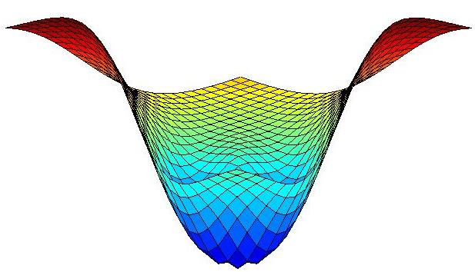
Software
https://uupharmacometrics.github.io/PsN/
ncappc simulations
SIR
modelAVERAGE available on www.bluetree.me
ncappc
https://cran.r-project.org/package=ncappc
PopED
Optimal experimental design software
Flexible description of models
Flexible description of design space
Flexible design optimization
Robust design criteria
Written in R (Package available via CRAN)
poped.sf.net

Slide 24
Extra slides

Slide 25
Bias reduction from model averaging
The accuracy of the calculated probability

